Slide 1


Advanced Coding Tools and Methodologies
SoniWeather Map
Davide Lorenzi, Nicolò Pisanu, Haokun Song
Notes:
Hi to all of you! We are here today to present our project SoniWeather Map.

Slide 2
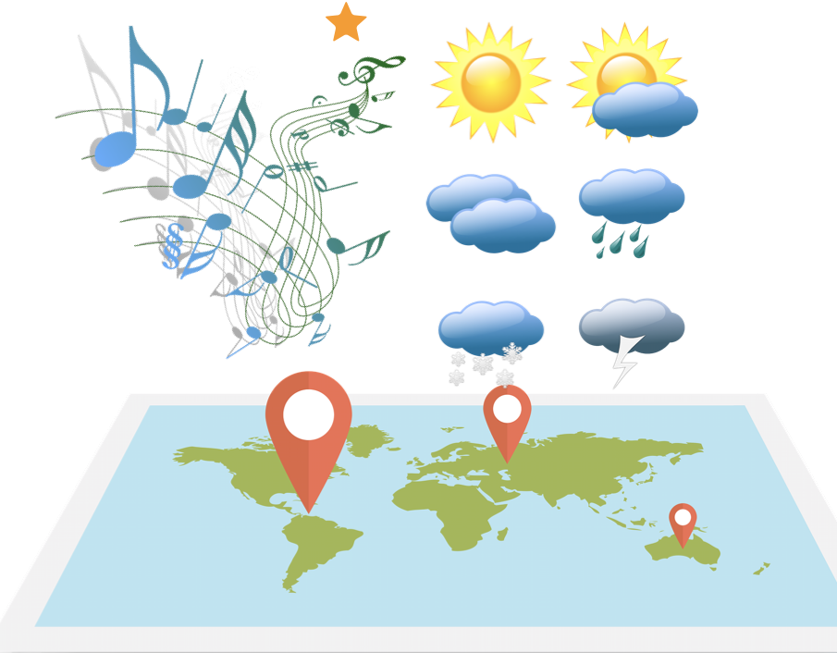
1. CONCEPT
Listen to the weather
Notes:
NICO
The general idea is to create a real-time sonification of the weather.
The idea came to me through the study of Sonification and listening to various sound art works. Plus I'm meteoropathic
Instead of just looking at the weather information of a place, the user can listen to the weather of that place!

Slide 3
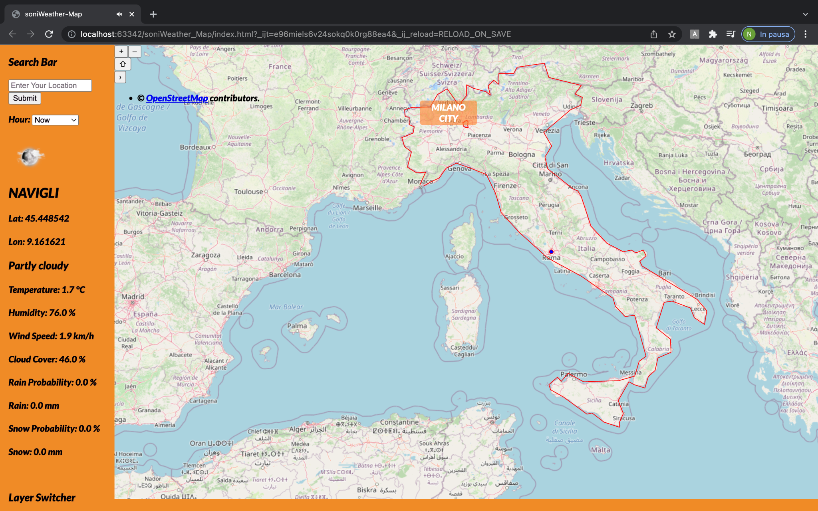
3 of 14
Notes:
NICO
This is the preview of the application. The user can click on the map or search for a location and immediately listen to the music generated by the weather!
Obviously he can also read the details and search for a specific hour. And now, we can have a closest view of the structure of the project:

Slide 4
2. STRUCTURE
Notes:
SONG

Slide 5
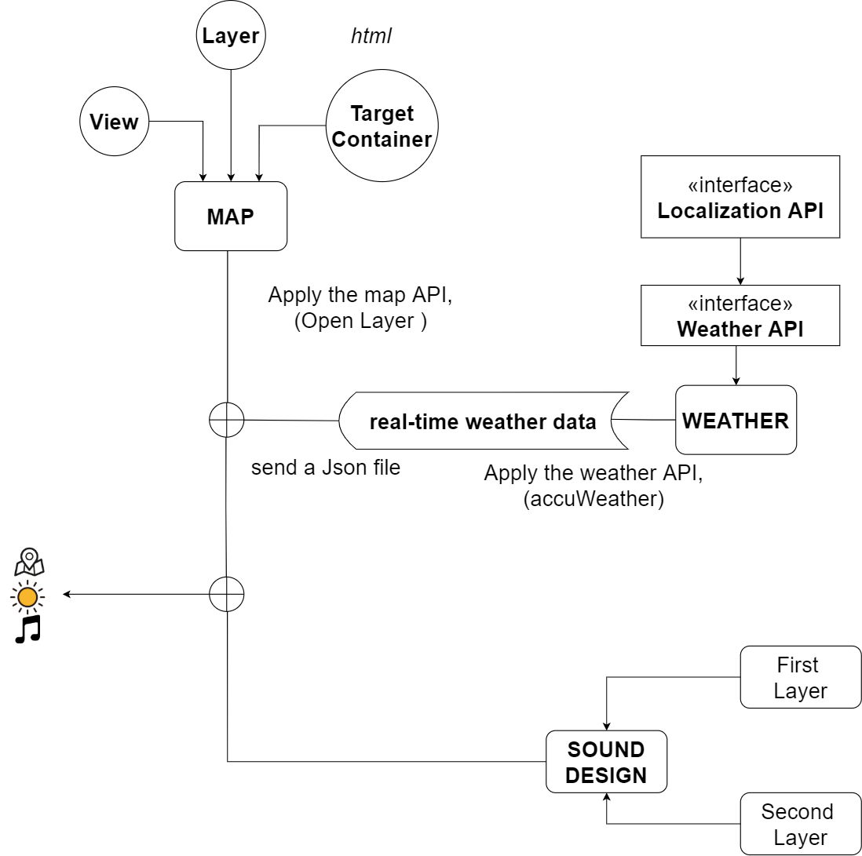
Main Components:
OpenLayer API
Accuweather
Sound Design
5 of 14
Notes:
SONG

Slide 6
a focus on the map
6 of 14
Notes:
SONG

Slide 7
a focus on the weather
7 of 14
Notes:
DAVE
_Localization API (divided in search by click and search by name with 2 separate functions) and Weather API
_We store all cities we have already found, both struct of cities and forecast, bind with the city key. When we look for a city, both click or search, we check if we already have the city in an array of cities, if yes we take the key from city struct and we use it to look for the relative forecast in the array of object forecast. This optimization allow us to do only 1 API request instead 2. We store data locally because at this stage is not intended to be persistend application that will work every day 24/24
_12 hour array (future proof) and user can select

Slide 8
3. SOUND DESIGN
8 of 14
Notes:
NICO
The sound design is based on a selection of weather parameters.
The sound must be linked to the different weather conditions, in order to create a sensation that evokes the atmospherical events. The user should listen to the sound and immediately understand what’s the weather like.
The sound is arranged in two different layers.

Slide 9
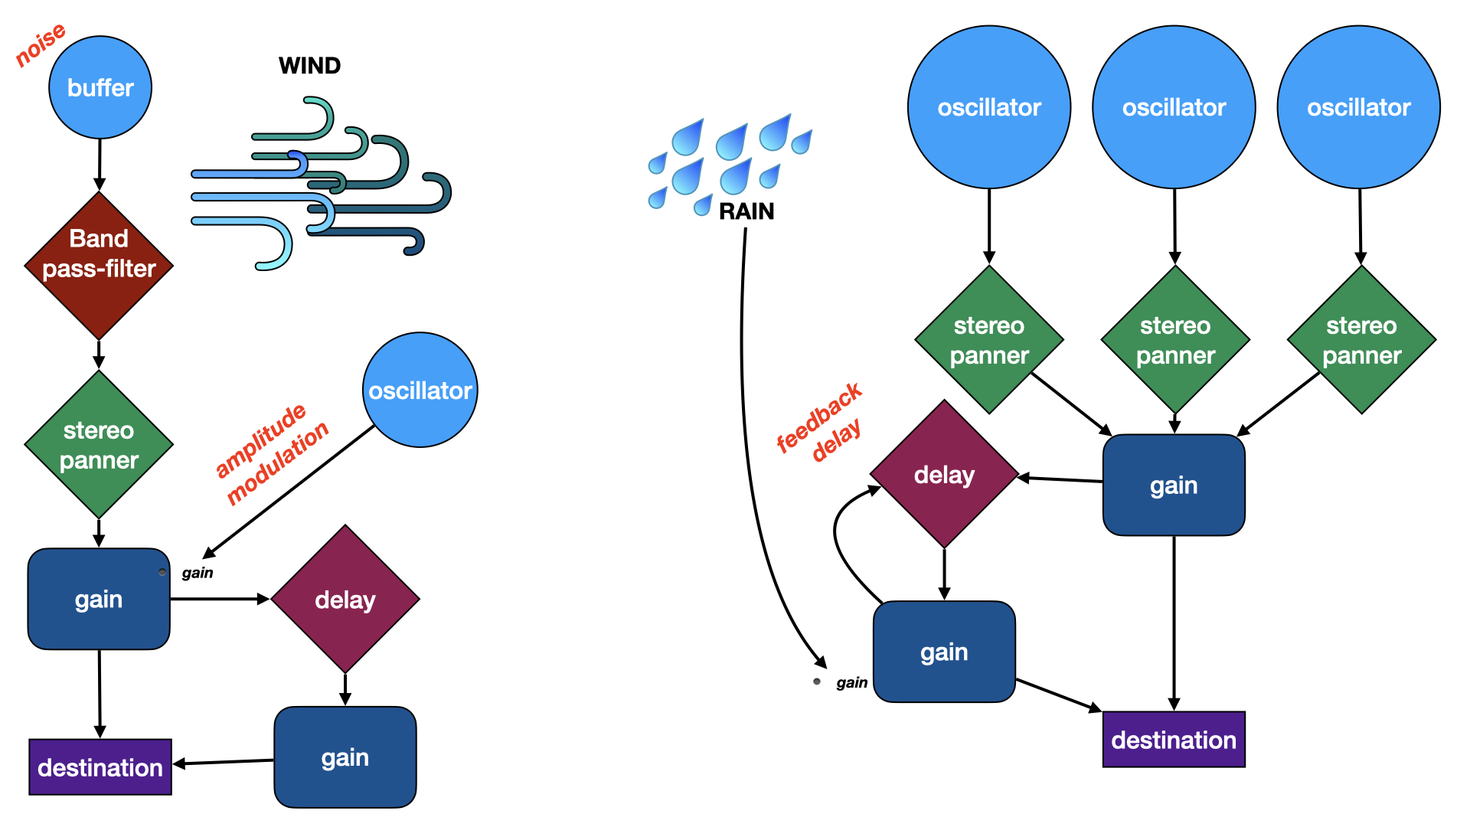
9 of 14
Notes:
NICO
The first sound layer describes the general atmospheric condition; the soundscape is continuous and chordal.
The chord sequence is consonant/dissonant according to the cloud cover percentage that influences the mood of a day.
The tonic pitch of each chord is obtained by mapping the temperature while humidity governs the amount of vibrato through a frequency modulation.

Slide 10
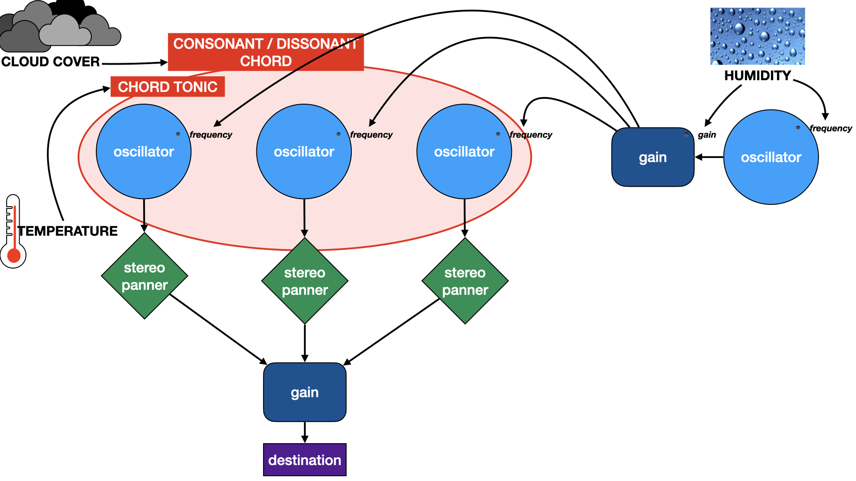
10 of 14
Notes:
NICO
The second layer contains sound objects that are not continuous and not necessarily present, like rain, snow or wind.
In this cases the sound objects are more didactic (didascalici), and recall the actual natural sounds.
All these functions are called continuosly and are synchronised with a timing.
The sound design script is created with the AudioContext interface

Slide 11
4. TECHNICAL DIFFICULTIES
Notes:
DAVE

Slide 12
CLASS INTERACTION
Complex data structure between different classes
SOUND GENERATION TIMING
Synchronisation of several sound functions, to obtain a proper musical composition
MAPPING
Transformation of weather parameters in sound parameters
COORDINATES SYSTEMS
Problems in manage coordinates for some values, due to the constraints of the representation system.
JSON PARSING
To retrieve big amount of informations coming from API, we need to destructure the JSON coming from the web into object and arrays of objects
12 of 14
Notes:
DAVE

Slide 13
5. FUTURE IMPLEMENTATION
Several further implementation are possible:
Sound evolution taking more weather information
Sound generation taking in account the alternation of the forecast in 12H
Create a stand alone implementation with Node.js
13 of 14
Notes:
DAVE

Slide 14
THANKS FOR YOUR ATTENTION!
Notes:
DAVE

